Slide 1
A MACHINE LEARNING FRAMEWORK FOR PREDICTION OF BREAST CANCER
By
G BHARGAV-15MIS0115

Slide 2
INTRODUCTION
Breast cancer is a malignant cell growth in the breast. If left untreated, the cancer spreads to other areas of the body. Excluding skin cancer, breast cancer is the most common type of cancer in women in India, accounting for one of every three cancer diagnoses.
The incidence of breast cancer rises after age 40. The highest incidence (approximately 80% of invasive cases) occurs in women over age 50.
Breast cancer is the most common cancer in women, affecting about 10% of all women at some stages of their life. In recent years, the incidence rate keeps increasing and data show that the survival rate is 88% after five years from diagnosis and 80% after 10 years from diagnosis. Early prediction of breast cancer is one of the most crucial works in the follow-up process.

Slide 3
It is the prime reason for demise of women. It is the second dangerous cancer after lung cancer. In the year according to the statistics provided by World Cancer Research Fund it is estimated that over 2 million new cases were recorded out of which 6 lakhs death were approximated. Of all the cancers, breast cancer constitutes of 11.6% in new cancer cases and come up with 24.2% of cancers among women. In case of any sign or symptom, usually people visit doctor immediately, who refer to on oncologist, if required. The oncologist can diagnose breast cancer by: Undertaking through medical history.
Breast cancer – extremely heterogeneous disease caused by interactions of both inherited and environment risk factors. Progressive accumulation of genetic and epigenetic changes in breast cancer cells. Tumors with similar clinical and pathological presentations may have different behaviors.
Breast cancer is a kind of cancer that develops from breast cells. Breast cancer usually starts off in the inner lining of milk ducts or the lobules that supply them with milk. A malignant tumor can spread to the different parts of the body.
Breast cancer can also occur in men, but it’s far less common.

Slide 4
SYSTEM SPECIFICATIONS
HARDWARE REQUIREMENTS
System : Pentium Dual Core
System type : 64 bit
Processor (Gen) : Any Processor
Hard Disk : Min 100 GB
Ram : Min 4GB
Speed : 1.1 GHz
SOFTWARE REQUIREMENTS
Operating system : Windows
Coding Language : PYTHON
UML’s : StarUml
Python version : 3.6
Other tools : RStudio

Slide 5
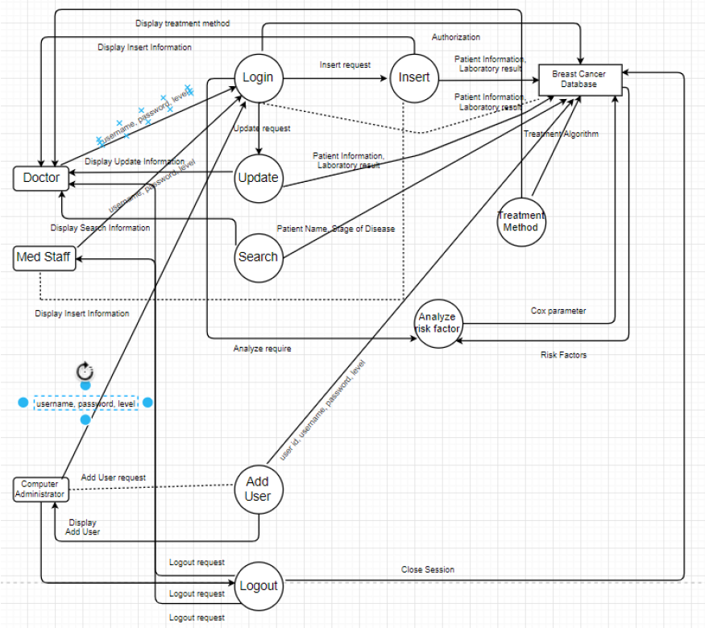
System Architecture

Slide 6
MODULE DESCRIPTION
Pre-processing
The pre-processing is the most important step in the mammogram analysis due to poor captured mammogram image quality. Pre-processing is very important to correct and adjust the mammogram image for further study and processing. There are Different types of filtering techniques are available for pre-processing. This filters used to improve image quality, remove the noise, preserves the edges within an image, enhance and smoothen the image. In this paper, we have performed various filters namely, average filter, adaptive median filter, average or mean filter, and wiener filter.
The steps to be taken in:
Mean Filter or Average Filter
Median Filtering
Adaptive Median Filter

Slide 7
Future Selection
It has been an attempt over last many years that how to detect and cure cancer. Cancer which can be of various types like breast cancer, lung cancer, throat cancer, blood cancer etc. is known to be the deadliest disease which still now have not got any cure
There are several levels of cancer from 1 to 6. However, on the good side if cancer is detected when it is in level 1 or 2 or at the very initial stage, there is a significant probability that it will get cured within a period of time. With the advent of new technologies in the field of medicine, we get new ideas of curing the disease with methods like machine learning. The problem for the cancer can be broadly classified into three types.
1. Firstly, the problem is to predict whether a person in a particular stage of cancer has the chance to survive or not.
2. Secondly, the problem is to predict whether a person who has already encountered the disease in the past and got cured, has the probability of having the same disease in future.
3. Thirdly, the domain in which we are working includes the detection of cancer at the earliest stage.

Slide 8
Classification
Classification of benign tumors can help the patients avoid undertaking needless treatments. Most of them show that classification techniques give a good accuracy in prediction of the type of tumor. Our methodology involves use of classification techniques like Support Vector Machine (SVM), K-Nearest Neighbor (K-NN), Logistic Regression, with Dimensionality Reduction technique i.e. Principal Component Analysis (PCA) .
A classification problem is when the result is a category like filtering emails “spam” or “not spam”. Unsupervised Learning: Unsupervised learning is giving away information to the machine that is neither classified nor labeled and allowing the algorithm to analyze the given information without providing any directions. In unsupervised learning algorithm the machine is trained from the data which is not labeled or classified making the algorithm to work without proper instructions. In our dataset we have the outcome variable or Dependent variable i.e. Y having only two set of values, either M (Malign) or B (Benign). So Classification algorithm of supervised learning is applied on it. We have chosen three different types of classification algorithms in Machine Learning.

Slide 9
Classification Techniques:
Logistic Regression:
Logistic Regression is a supervised machine learning technique, employed in classification jobs (for predictions based on training data).
Logistic Regression uses an equation similar to Linear Regression but the outcome of logistic regression is a categorical variable whereas it is a value for other regression models.
Binary outcomes can be predicted from the independent variables. The outcome of dependent variable is discrete. Logistic Regression uses a simple equation which shows the linear relation between the independent variables.

Slide 10
K-NN (K-Nearest Neighbor):
K-Nearest Neighbor is a supervised machine learning algorithm as the data given to it is labeled. It is a non-parametric method as the classification of test data point relies upon the nearest training data points rather than considering the dimensions (parameters) of the dataset.
In Classification technique, it classifies the objects based on the k closest training examples in the feature space.
It catches the idea of proximity based on mathematical formula called as Euclidean distance, calculation of distance between two points in a plane.

Slide 11
SVM (Support Vector Machine):
Support Vector Machine is a supervised machine learning algorithm which is doing well in pattern recognition problems and it is used as a training algorithm for studying classification and regression rules from data.
SVM is most precisely used when the number of features and number of instances are high. A binary classifier is built by the SVM algorithm.
This binary classifier is constructed using a hyper plane where it is a line in more than 3 – dimensions.

Slide 12
Classification states:
1. Benign
Benign is a state of tumor or lump which does not spread across body. In simple terms these are non-cancerous type of tumor.
2. Malignant
Malignant is a state of tumor or lump which spreads across the body. In simple terms these are cancerous type of tumor.

Slide 13
NOVELTY
EXISTING SYSTEM:
Rule based approach is used for classification which gives static range value for different classes. Therefore we will not able dynamic images or outlier behaviour images.
Multi classification problem is not optimized and ignore the class imbalance problem. Therefore in learning all classes is not input in learning phase so it became a biased learning.
Features set is not normalize. Therefore different features show different outputs and show different representation during training phase of classifiers.

Slide 14
PROPOSED SYSTEM:
In our proposed system, mammogram image can be enhancement using Gaussian filter. Second the segmentation is done using Fuzzy C means for partitioning the mammogram image into multiple segments to identify the mass easily and features are extracted using HWT (Haar Wavelet Features). Further tumor has been analyzed and classified using Multi –SVM (Support Vector Machine) classifier.
SVMs deliver a unique solution, since the optimality problem is convex. This is an advantage compared to Neural Networks, which have multiple solutions associated with local minima and for this reason may not be robust over different samples.

Slide 15
ADVANTAGES:
More Accuracy
Reduced time consumption

Slide 16
CONCLUSION
A plan for the diagnosis and treatment of cancer is a key component of any overall cancer control plan. Its main goal is to cure cancer patients or prolong their life considerably, ensuring a good quality of life. In order for a diagnosis and treatment programme to be effective, it must never be developed in isolation. It needs to be linked to an early detection programme so that cases are detected at an early stage, when treatment is more effective and there is a greater chance of cure. It also needs to be integrated with a palliative care programme, so that patients with advanced cancers, who can no longer benefit from treatment, will get adequate relief from their physical, psychosocial and spiritual suffering. Furthermore, programmes should include a awareness-raising component, to educate patients, family and community members about the cancer risk factors and the need for taking preventive measures to avoid developing cancer.

Slide 17
FUTURE SCOPE OF THE PROJECT
Where resources are limited, diagnosis and treatment services should initially target all patients presenting with curable cancers, such as breast, cervical and oral cancers that can be detected early. They could also include childhood acute lymphatic leukaemia, which has a high potential for cure although it cannot be detected early. Above all, services need to be provided in an equitable and sustainable manner. As and when more resources become available, the programme can be extended to include other curable cancers as well as cancers for which treatment can prolong survival considerably.

